Slide 1


PROJECT PRESENTATION
College Management System with AI Agent (AIRA)
KABILAN.S.S [22TH0024]
LOGAPRIYAN.A [22TH0028]
RAJESH.R [22TH0043]
Department of Information Technology Rajiv Gandhi College of Engineering & Technology

Slide 2


Abstract
Objective
To develop a comprehensive, scalable College Management System integrated with an intelligent AI agent, AIRA, to streamline administrative and academic operations.
Key Outcomes
Refined Requirements: Tailored for credit-based semester systems.
Scalable Architecture: Section-centric design ready for multi-campus deployment.
Innovation
Integration of a Dual-LLM Engine (Google Gemini + Local Llama 3.2) providing a natural language interface for complex database queries.
Data Privacy: Hybrid local-cloud AI approach ensures sensitive data security.

Slide 3

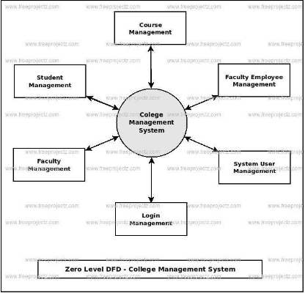
Introduction & Architecture
A digitized solution for technical colleges operating on a credit-based semester system. The core innovation is AIRA, a floating chat assistant available on every screen.
System Architecture Highlights
•
Section-Centric Design: Scheduling and attendance are linked to 'Sections' (e.g., CSE-A), not just batches, allowing granular control.
•
Multi-Campus Ready: The 'College' entity at the root allows the system to scale to multiple branches without schema changes.
•
Role-Based Access: Strict hierarchy from Super Admin to Staff.

Slide 4





Core Administration Modules
1. Authentication
2. College & Dept
Role-based login (Super Admin, Admin, HOD, Staff), session handling, and comprehensive activity logs for security auditing.
Manages multi-campus metadata and department structures (e.g., CSE, ECE) with Head of Department (HOD) mapping.
3. Curriculum
4. Batches & Sections
Defines Courses (B.Tech), Semesters, and Subjects with credit mapping and department allocation.
Manages admission years (Batches) and dynamic Sections (A, B, C) which serve as the primary grouping unit.
5. Staff Management
Profiles, designations, and critical Subject Allocation (Staff ↔ Subject ↔ Section).

Slide 5
Academic & Finance Modules
6. Timetable
7. Assessments
Complex scheduling linking Period + Room + Staff + Subject + Section.
Internal/External exams, marks entry, and auto-calculation of GPA/CGPA with manual overrides.
8. Attendance
9. Fee Management
Granular period-wise tracking with auto-derived day-wise summaries.
3-Tier Structure: Fee Structure → Components → Payments. Tracks dues and receipts efficiently.
10. Reporting
PDF/Excel generation for mark sheets, defaulter lists, and attendance summaries.

Slide 6


Existing System Challenges
Manual Navigation
Users must navigate deep menu trees to find simple data (e.g., "Students with <75% attendance").
Rigid Reporting
Custom reports require SQL knowledge or manual Excel aggregation. No instant, flexible data retrieval.
Limited Access
Strictly for Admin/Faculty. No student portal for viewing marks or fee status.
Complex Fee Handling
Manual management of quotas (Govt, Mgmt, Scholarship) is error-prone and time-consuming.

Slide 7
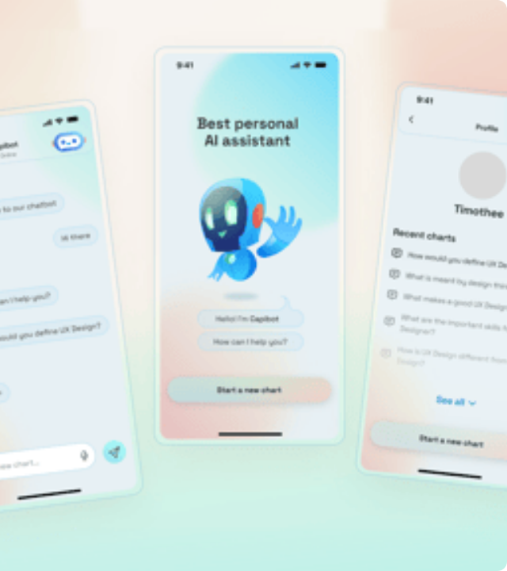
AIRA: AI-Powered Assistant
An intelligent overlay present on every screen, providing a natural language interface for database operations.
Context Aware
Knows exactly which page and section you are viewing.
Smart Actions
"Show me CSE attendance < 75%" or "Generate fee report".
Role Restricted
Strictly mirrors the logged-in user's permissions.

Slide 8


Hardware & Software Stack
Frontend: HTML, CSS, JS (Vanilla for performance).
Backend: Python (FastAPI) for native JSON handling.
Database: MySQL (XAMPP) for structured financial records.
AI Core: Ollama (Llama 3.2) + Google Gemini API.

Slide 9




Future Enhancements
Student Portal & App
Currently, the system is Admin/Staff focused. Future versions will include a dedicated student portal and mobile app for viewing marks and attendance.
Advanced Analytics
Integration of predictive models to identify students "At-Risk" of dropping out based on attendance and marks data trends.
Voice Integration
Expanding AIRA to accept voice commands for hands-free operation in classrooms or labs.

Slide 10




Conclusion
The College Management System with AIRA bridges the gap between traditional database management and modern AI capabilities.
Efficiency
Intelligence
Security

Slide 11





Image Sources
https://www.freeprojectz.com/sites/default/files/xCollege,P20Management,P20System,P20Zero,P20Level.jpeg.pagespeed.ic.RCxL_NAFnQ.jpg
Source: www.freeprojectz.com
https://hackaday.com/wp-content/uploads/2026/01/digitize_feat.jpg?w=800
Source: hackaday.com
https://elements-resized.envatousercontent.com/elements-cover-images/7adb7040-45dd-4987-97b1-c14beae353b8?w=433&cf_fit=scale-down&q=85&format=auto&s=0480af9f2f0aa731f73ff758e524fcd4d439404eaab0cf23bcea562616ef36d6
Source: elements.envato.com
https://blog.logrocket.com/wp-content/uploads/2021/10/server-side-rendering-fastapi-mysql.png
Source: blog.logrocket.com
https://www.bostondigital.com/_next/image?url=http%3A%2F%2Fbackend.bostondigital.com%2Fsites%2Fdefault%2Ffiles%2Fstyles%2Fwide_800_2x%2Fpublic%2F2018-05%2FBlog_Header_67.jpg%3Fitok%3Db6kMJZiP&w=1920&q=100
Source: www.bostondigital.com

